Slide 1

Today’s objective
DATA ANALYTICS | IRONHACK

Slide 2

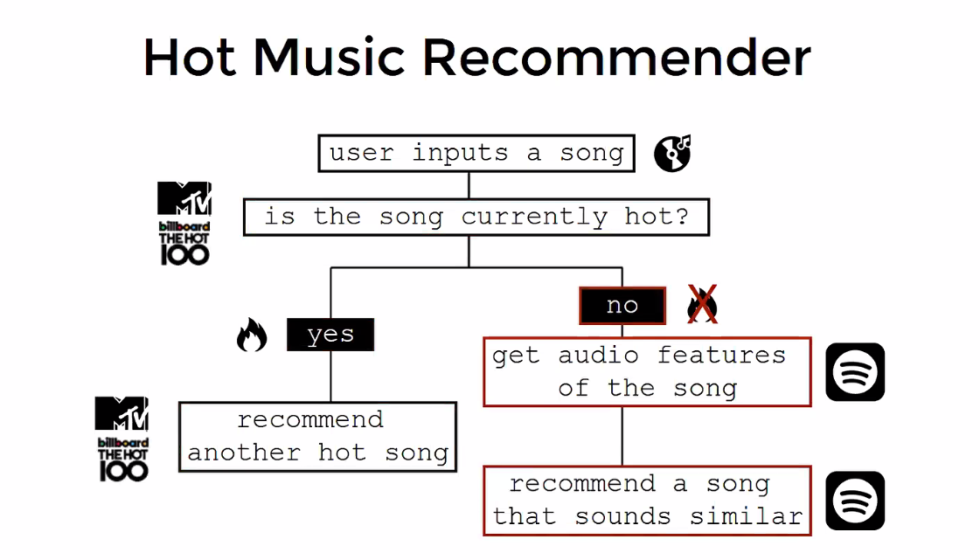
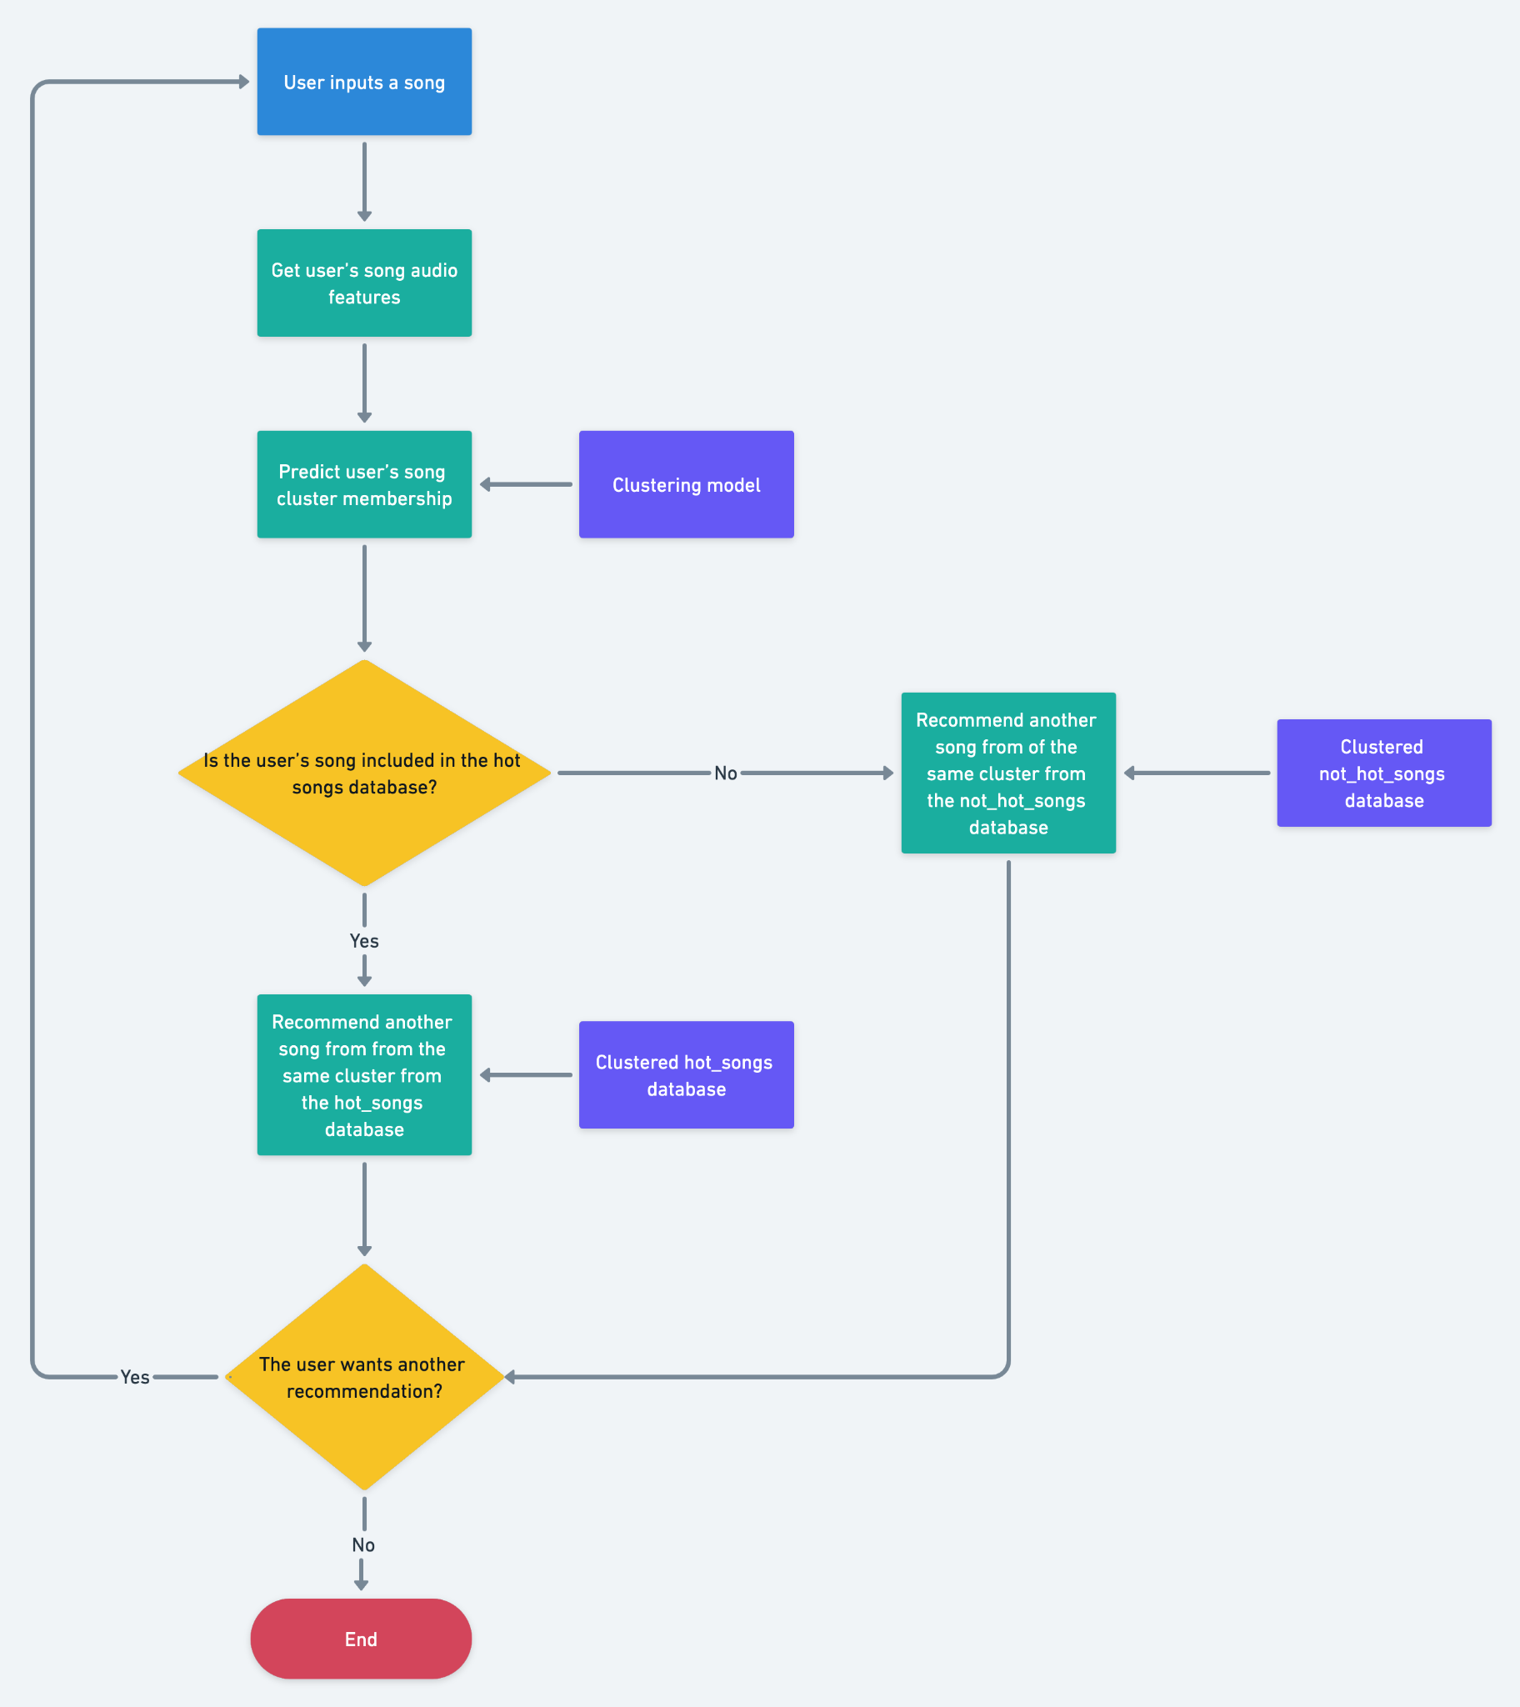
IRONHACK BOOTCAMP
Desired music recommender workflow

Slide 3
IRONHACK BOOTCAMP
Today’s objectives (I):
Create a function to scrape the Billboards 100 HOT songs and create a data frame of songs with them including:
Song’s name
Song’s artist
Save the resulting data frame into a csv file in the current folder.

Slide 4
IRONHACK BOOTCAMP
Today’s objectives (II):
Create a not_hot100 songs file in the current folder including:
Song’s name
Song’s artist

Slide 5


